Slide 1
National Economic Education Delegation
Vision
  One day, the public discussion of policy issues will be grounded in an accurate perception of the underlying economic principles and data.
Mission
  NEED unites the skills and knowledge of a
  vast network of professional economists to promote understanding of the economics of policy issues in the United States.
NEED Presentations
  Are nonpartisan and intended to reflect the consensus of the economics profession.

Slide 2
Trade Policies and the Pandemic:
Implications for the Auto Sector
Alan V. Deardorff
University of Michigan
Presentation for the Automotive Futures Research Conference,
“How Will New Trade Relations and the Global Pandemic
Affect the Globalization of the Industry?”
Online, University of Michigan
April 29, 2020

Slide 3
Outline
Recent Trade Policies
Effects of the Pandemic
Prospects for the Future

Slide 4
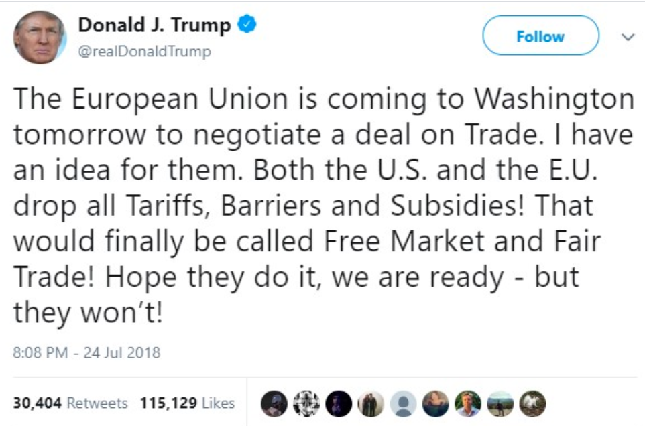

Slide 5
Recent Trade Policies
Tariffs by Trump
  Tariffs on steel and aluminum
  Tariffs on China
  Threat of tariffs on cars (still pending)
  Threat of tariffs on Mexico (resolved)
  Tariffs on EU, retaliation for Airbus

Slide 6
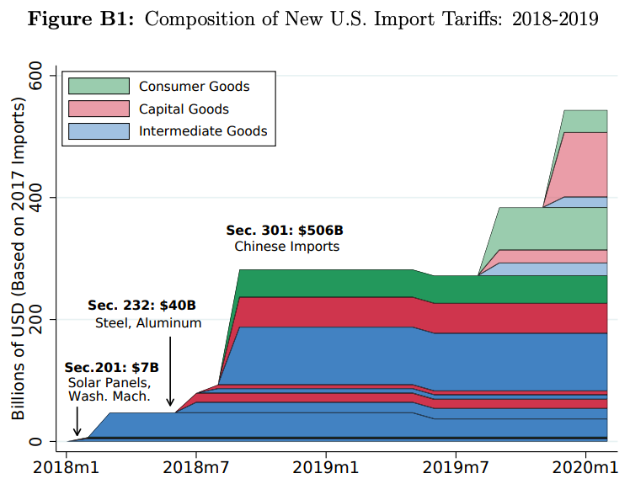
Source: Flaan & Pierce 2020
Notes:
Flaan and Pierce 2020
https://www.federalreserve.gov/econres/feds/files/2019086pap.pdf

Slide 7
Recent Trade Policies
Other Trade Actions by Trump
  Amendment of Korea-US FTA
    Extends 25% tariff on light trucks
  Renegotiation of NAFTA into USMCA
    Greater North American auto content
    Minimum value added by >$16 labor
  Restrictions on trade with Huawei
    May limit quality of US 5G telecom tech
  Block appointments to WTO

Slide 8
Recent Trade Policies
Trade Actions by Others
  Retaliatory tariffs by many countries
  Retaliatory tariffs by China (Trade War)
    “Phase One” truce

Slide 9
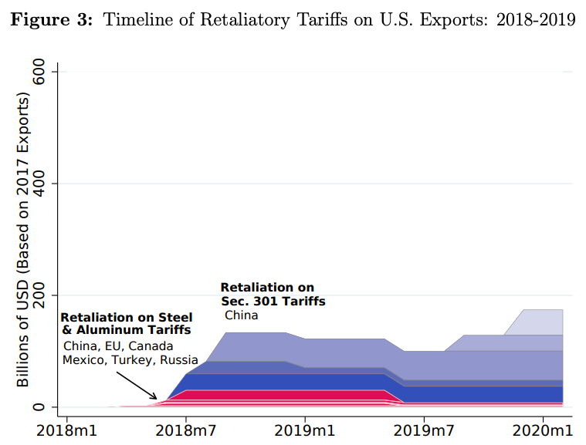
Source: Flaan & Pierce 2020
Notes:
Flaan and Pierce 2020
https://www.federalreserve.gov/econres/feds/files/2019086pap.pdf

Slide 10
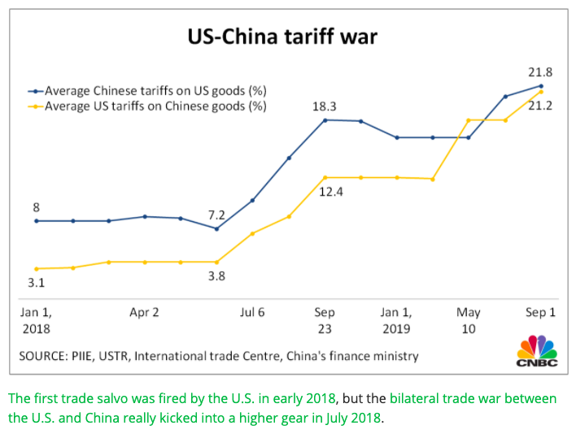
Source: CNBC.com
Notes:
SEPTEMBER 18, 2019 | Yen Nee Lee, CNBC.com
http://nbr.com/2019/09/18/these-4-charts-show-how-us-china-trade-has-changed-during-the-tariff-dispute/

Slide 11
Effects of the Pandemic
Effects of the Pandemic on Economies
  Travel halted
  Stock markets fall
  Factories shut down
  Supply chains interrupted
  Trade plummets
  Unemployment
  Reduced GDP
  Panic buying and shortages

Slide 12
Travel

Slide 13
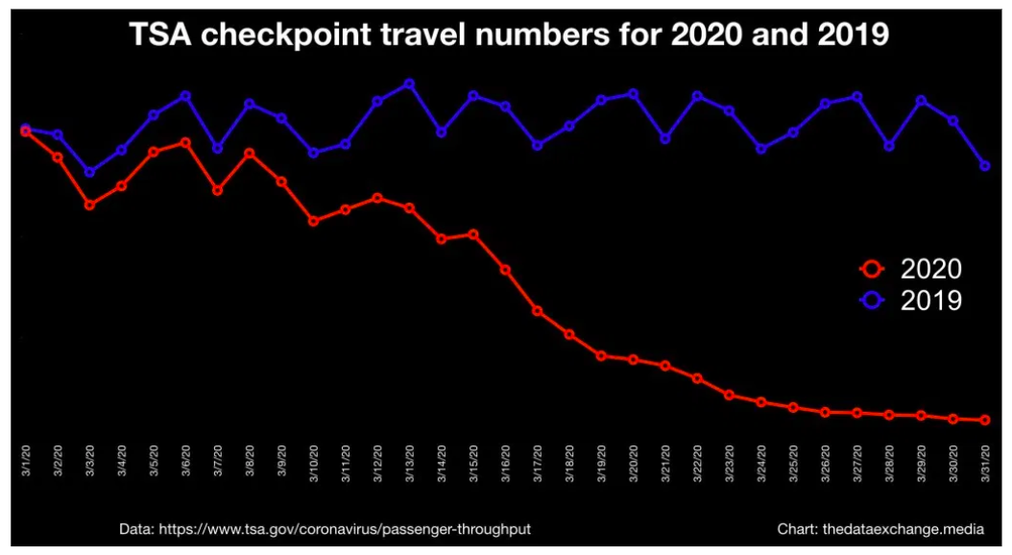
(MARCH)
Source: Lorica April 1, 2020 The Data Exchange
Notes:
Lorica April 1, 2020 The Data Exchange
https://thedataexchange.media/one-simple-chart-air-travel-in-the-us

Slide 14
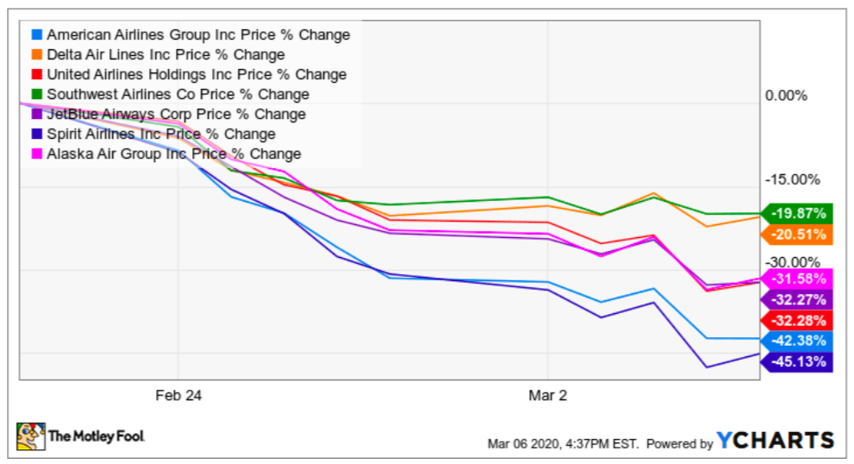
Airline Stock Prices
Notes:
The Motley Fool
https://www.fool.com/investing/2020/03/08/should-you-buy-or-sell-airline-stocks-right-now.aspx

Slide 15
Stock Markets

Slide 16
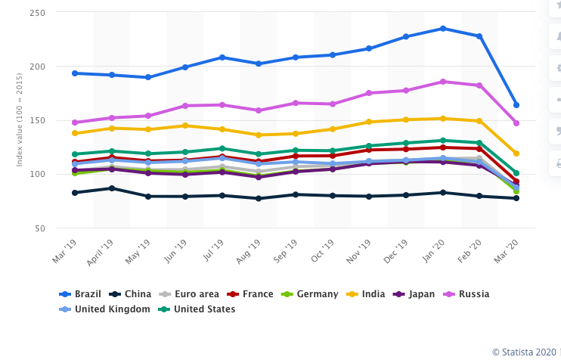
Share price index in major developed and emerging economies from March 2019 to March 2020
US
Source: Statista
Notes:
Statista
https://www.statista.com/statistics/1034575/share-price-index-in-major-developed-and-emerging-economies/

Slide 17
Factory Shut-downs

Slide 18
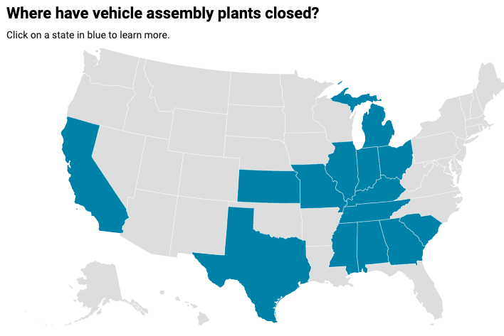
Plans to restart
As of Apr 22:
Ford: None
GM: None
FCA: sometime after May 3
Others: See map
5/4
5/11
5/4
5/4
5/4
5/3
4/27
5/11
4/27
5/4
5/4
4/13
Reported yesterday: Ford, GM, & FCA
targeting May 18 to resume limited production (WSJ)
5/4
Source: Automotive News, March 25, 2020
Notes:
Automotive News, March 25, 2020
https://www.autonews.com/manufacturing/follow-latest-assembly-plant-closings

Slide 19
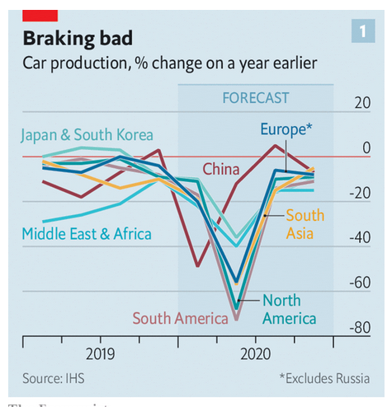
Source: Economist Apr 23, 2020
Notes:
Economist
https://www.economist.com/briefing/2020/04/23/the-worlds-car-giants-need-to-move-fast-and-break-things

Slide 20
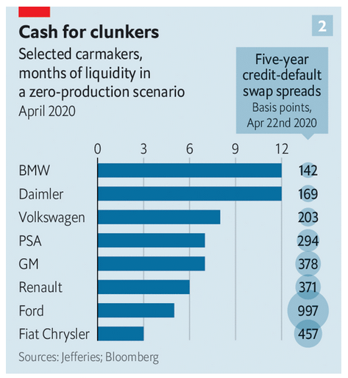
Source: Economist
Notes:
Economist
https://www.economist.com/briefing/2020/04/23/the-worlds-car-giants-need-to-move-fast-and-break-things

Slide 21
Supply Chains

Slide 22
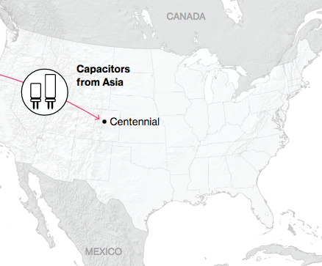
NAFTA and the Auto Supply Chain
Black, Diamond, and Merrill, “One Tiny Widget’s Dizzying Journey Shows Just How Critical Nafta Has Become,” Bloomberg, February 2, 2017.

Slide 23
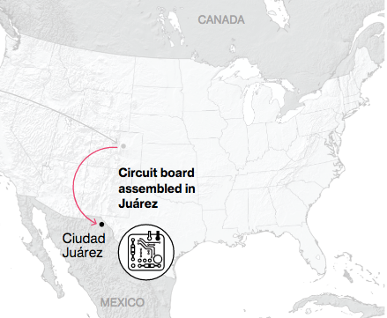
NAFTA and the Auto Supply Chain
Black, Diamond, and Merrill, “One Tiny Widget’s Dizzying Journey Shows Just How Critical Nafta Has Become,” Bloomberg, February 2, 2017.

Slide 24
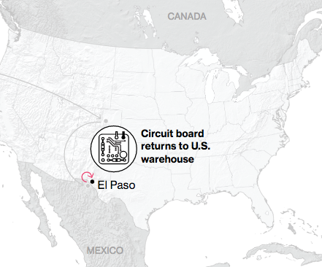
NAFTA and the Auto Supply Chain
Black, Diamond, and Merrill, “One Tiny Widget’s Dizzying Journey Shows Just How Critical Nafta Has Become,” Bloomberg, February 2, 2017.

Slide 25
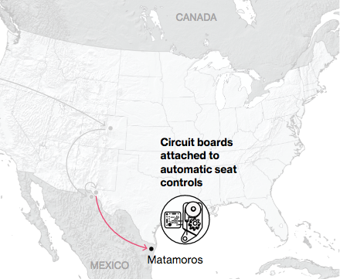
NAFTA and the Auto Supply Chain
Black, Diamond, and Merrill, “One Tiny Widget’s Dizzying Journey Shows Just How Critical Nafta Has Become,” Bloomberg, February 2, 2017.

Slide 26
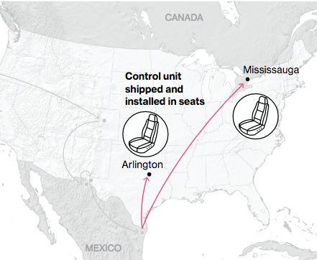
NAFTA and the Auto Supply Chain
Black, Diamond, and Merrill, “One Tiny Widget’s Dizzying Journey Shows Just How Critical Nafta Has Become,” Bloomberg, February 2, 2017.

Slide 27
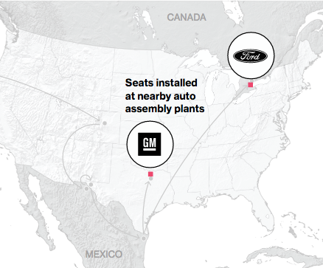
NAFTA and the Auto Supply Chain
Black, Diamond, and Merrill, “One Tiny Widget’s Dizzying Journey Shows Just How Critical Nafta Has Become,” Bloomberg, February 2, 2017.

Slide 28
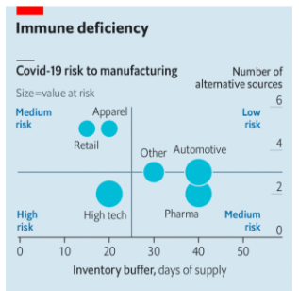
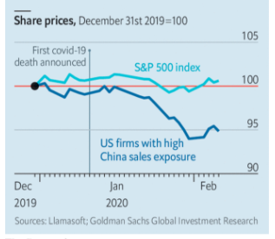
The new coronavirus could have a lasting impact on global supply chains
Source: Economist Feb 15, 2020
Notes:
Economist Feb 15, 2020
https://www.economist.com/international/2020/02/15/the-new-coronavirus-could-have-a-lasting-impact-on-global-supply-chains

Slide 29
Trade

Slide 30
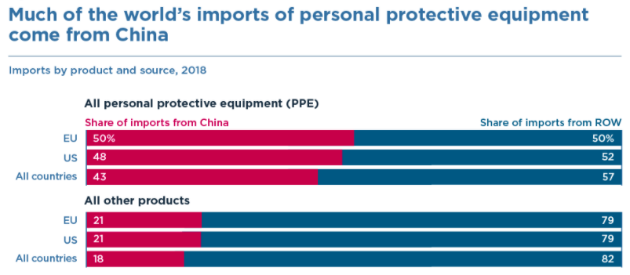
Source: Bown (2020)
Notes:
Bown (2020), “COVID-19: China's exports of medical supplies provide a ray of hope,” PIIE
https://www.piie.com/blogs/trade-and-investment-policy-watch/covid-19-chinas-exports-medical-supplies-provide-ray-hope

Slide 31
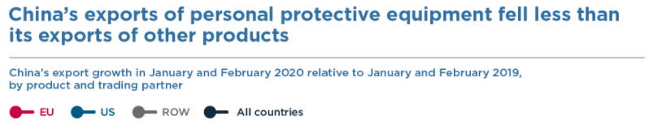
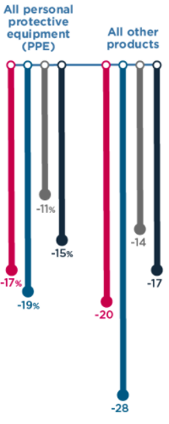
Source: Bown (2020)
Notes:
Bown (2020), “COVID-19: China's exports of medical supplies provide a ray of hope,” PIIE
https://www.piie.com/blogs/trade-and-investment-policy-watch/covid-19-chinas-exports-medical-supplies-provide-ray-hope

Slide 32
Unemployment

Slide 33
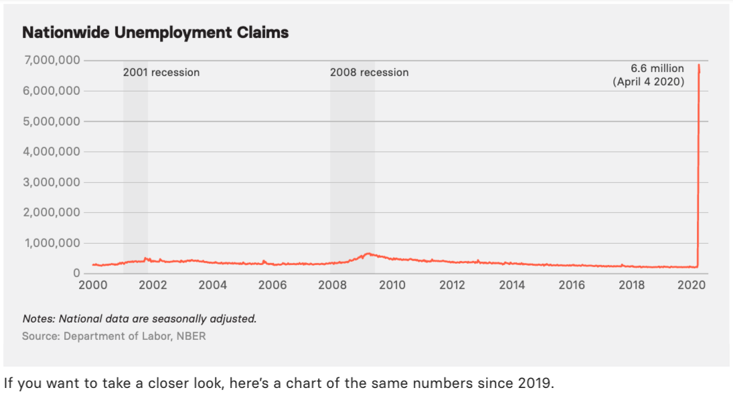
Source: Buzzfeed
Notes:
BuzzFeed News
https://www.buzzfeednews.com/article/lamvo/coronavirus-update-charts-unemployment-claims-laid-off-jobs

Slide 34
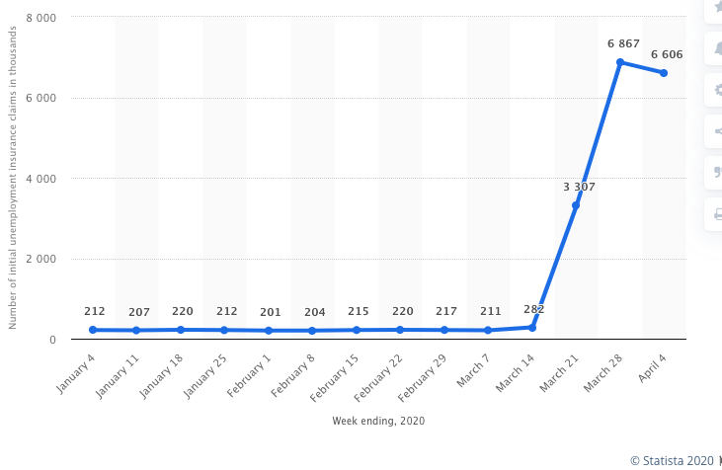
Number of Initial Unemployment Insurance Claims, thousands
Source: Statista
Notes:
Statista
https://www.statista.com/statistics/1107247/unemployment-insurance-initial-claims-weekly/

Slide 35
GDP

Slide 36
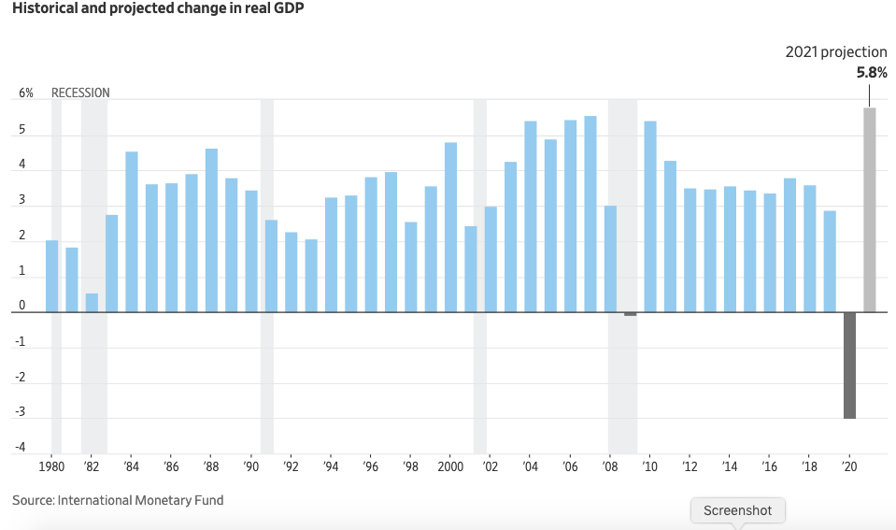
Historical and projected change in world real GDP
Source: WSJ Apr 15, 2020
Notes:
Zumbrun, WSJ Apr 15, 2020
https://www.wsj.com/articles/coronavirus-afflicted-global-economy-is-almost-certainly-in-recession-11586867402

Slide 37
Shortages

Slide 38
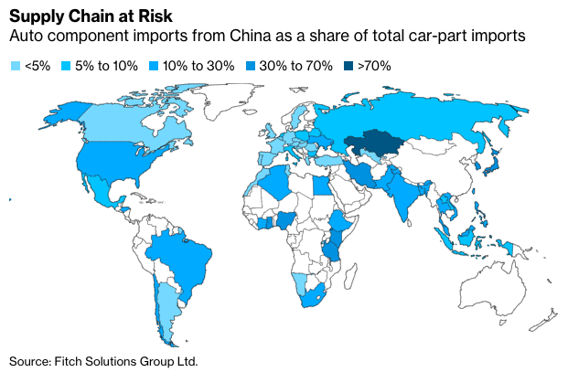
Source: Bloomberg News
Notes:
Bloomberg News
https://www.bloomberg.com/news/articles/2020-04-15/china-s-fledgling-car-rebound-faces-risks-of-parts-shortage

Slide 39
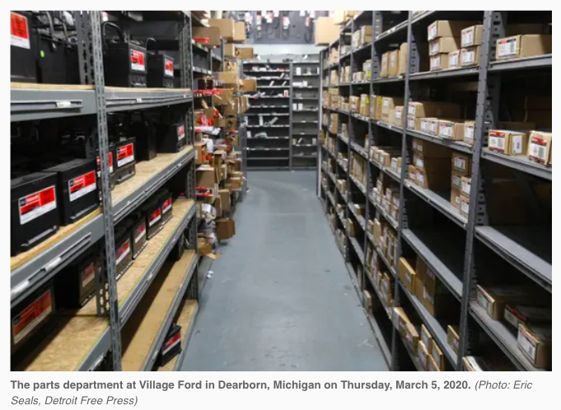
Source: Detroit Free Press
Notes:
Lawrence et al., “Why your trip to the auto repair shop should happen sooner than later,” Detroit Free Press, March 6, 2020.
https://www.freep.com/story/money/cars/2020/03/06/coronavirus-covid-auto-parts-supply-chain-china/4964022002/

Slide 40
Effects of the Pandemic
Headlines
  Mar 2 CNBC: Automakers are ‘scrambling’ for parts and preparing war rooms as coronavirus spreads
  Mar 10 NBC News: Carmakers — and car owners — could soon feel the impact of the coronavirus
  Mar 12 Detroit News: J.D. Power warns coronavirus could cause car part shortages
  Mar16 USNews: Automakers Dodged Parts Shortage, but Virus Poses New Threat
  Mar 22 NNY 360: Coronavirus could cause car part shortages
  Mar 29 Automotive Logistics: Critical parts shortage continues
  Apr 15 Bloomberg: China’s Fledgling Car Rebound Faces Risks of Parts Shortage

Slide 41
Thank you!
Any Questions?
Alan V. Deardorff
Ford School of Public Policy
University of Michigan
www.NEEDelegation.org

